Slide 1

Use Case 5: Customer Spend Behavioral Analytics
Case Study Submitted by: Sharan Sasi
Email: sharanssi@gmail.com

Slide 2
Contents
1
2
3
4
5
Business Problem Overview
Data Overview
Exploratory Data Analysis
Customer Segmentation
Insights and conclusion

Slide 3

Business Problem Overview
Identify the spend behaviour of the customers in the dataset and bring out spend insights based on age and gender.
Link to the case-study: https://www.kaggle.com/datasets/shrutimechlearn/customer-data

Slide 4
Data Overview
The data presents customer details for Gender, Age, Annual Income and Spending Score.
The Genre column represents Gender
Annual Income column is in the unit of thousand Dollars.
The spending score can be between 0 to 100.

Slide 5
Data Observation
Customer dataset has 200 rows and 5 columns
No missing values or nulls in the dataset
No duplicates values in the dataset
CustomerID is just number in sequence, dropping that as it is reduntat
No of data points for female is more than male
Average age is around 40, with minimum age of 18 and max age of 70
Average annual income is 60k
Average spending score is 50

Slide 6
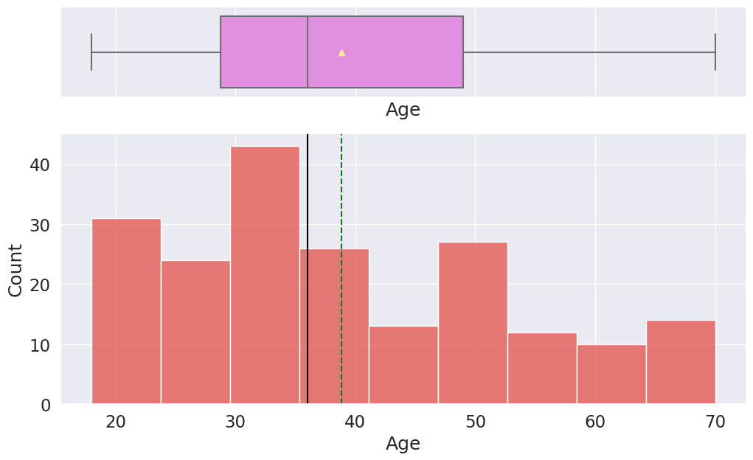
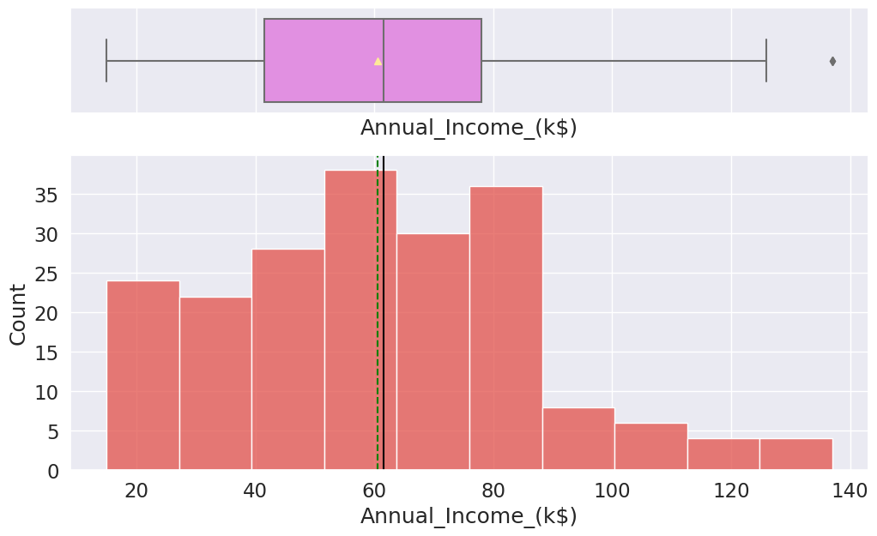
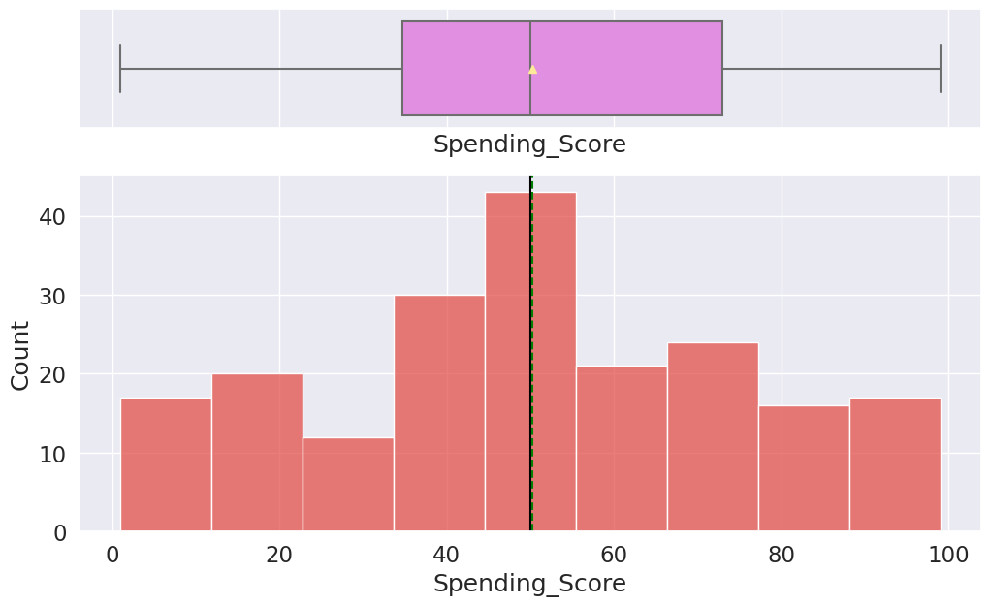
Exploratory Data Analysis (EDA)
Univariate Analysis
Age
Annual Income
Spending Score
We have mean age towards 40, more people in 20-40 age bracket
Average annual income is around 60k, more number of people earning in the income bracket of 50-90k
Mean spending score is around 50

Slide 7
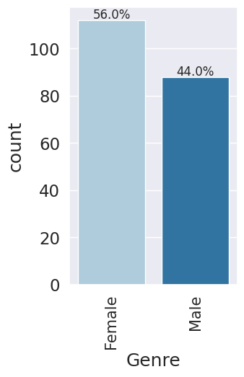
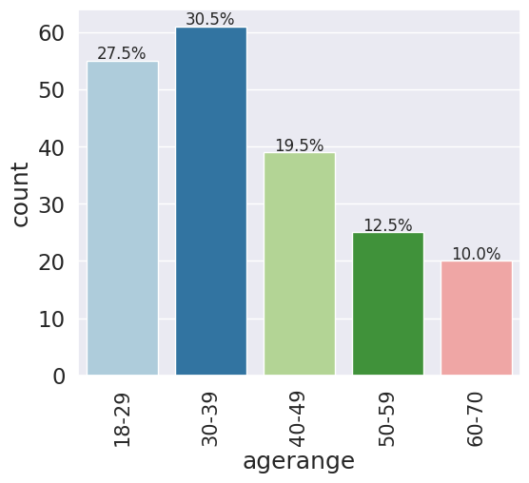
Exploratory Data Analysis (EDA)
Univariate Analysis
Gender
Age Range
We have more female representation that Male
Most observation belongs to 30-39 range

Slide 8
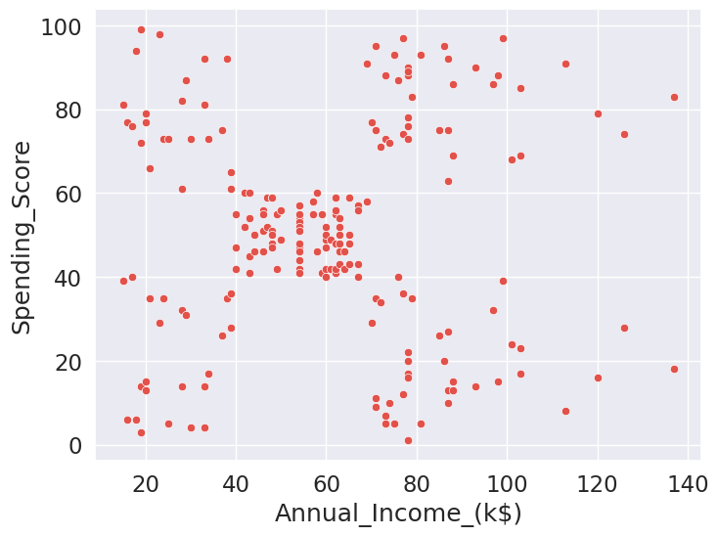
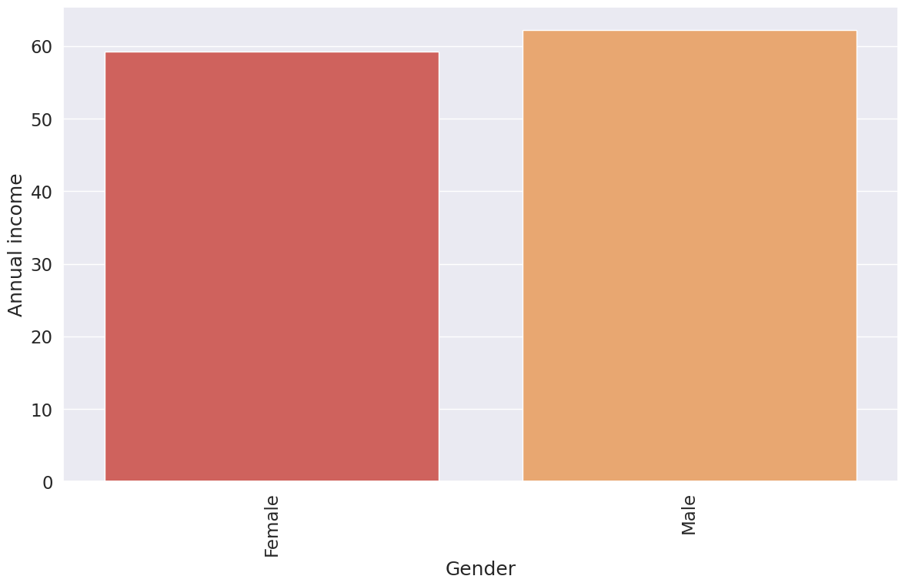
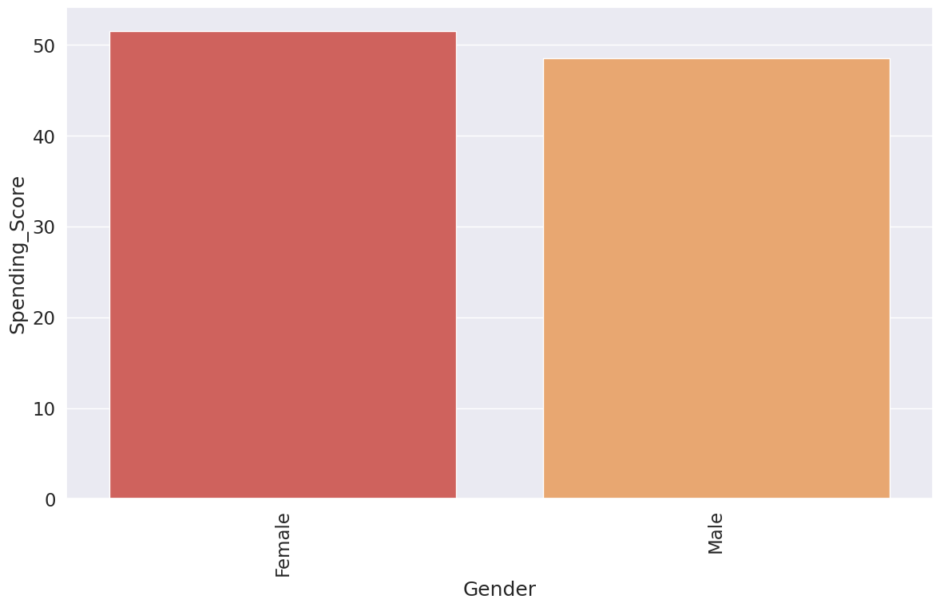
Exploratory Data Analysis (EDA)
Bivariate Analysis
Annual income vs Spending score
Gender wise annual income
Gender wise spending score
Spending score is not directly correlated to annual income
Even if we have more female data points, the average income of male is higher than female
Average spending score of female is higher which means female spends more in the shopping mall than male

Slide 9
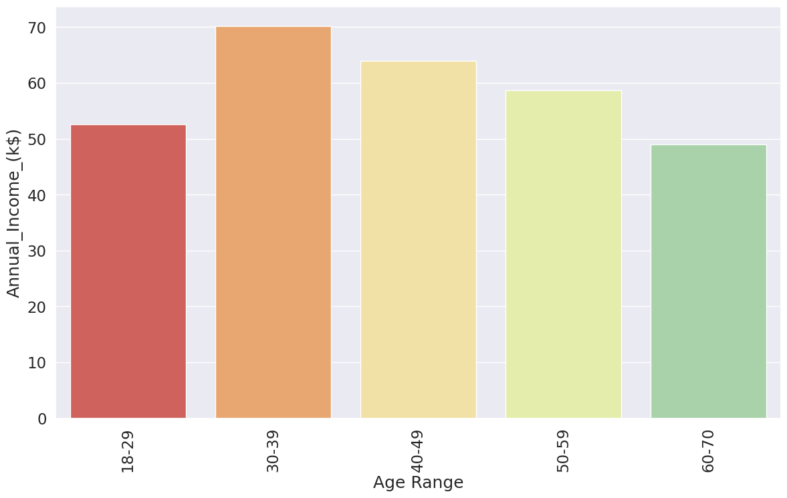
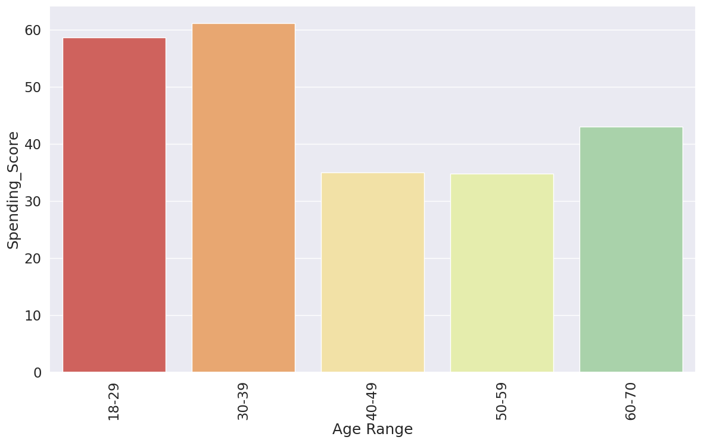
Exploratory Data Analysis (EDA)
Bivariate Analysis
Average income of each age group
Average spending score of each age group
Mean income of age group 30-40 is the highest then, followed by 40-50 age group
Younger people spend more
Age-group 18-40 is the highest spenders

Slide 10
Customer Segmentation
Done customer segmentation at the following levels of data:
Customer segment based on annual income and spending score
Customer segment based on age and annual income
Customer segment based on age and spending score
Gender wise segment based on annual income and spending score
Algorithm used for Clustering/Segmenting:
K-Means clustering

Slide 11
What is K-Means Clustering?
K-means clustering is a type of unsupervised learning, which is used when you have unlabelled data (i.e., data without defined categories or groups). The goal of this algorithm is to find groups in the data, with the number of groups represented by the variable K. The algorithm works iteratively to assign each data point to one of K groups based on the features that are provided. Data points are clustered based on feature similarity. The results of the K-means clustering algorithm are:
The centroids of the K clusters, which can be used to label new data
Labels for the training data (each data point is assigned to a single cluster)

Slide 12
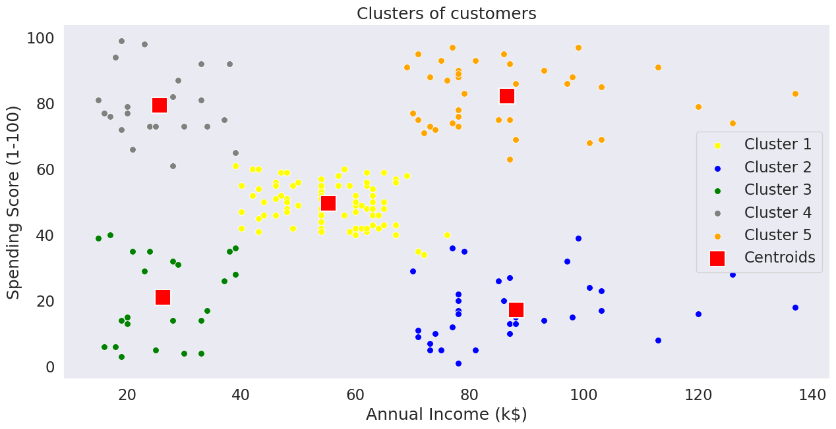
Customer segment based on annual income and spending score
This clearly segments customer based on annual income and spending score
With this segment we can define 5 different customer groups:
Low income low spenders
Low income high spenders
Average income average spenders
High income low spenders
High income high spenders

Slide 13
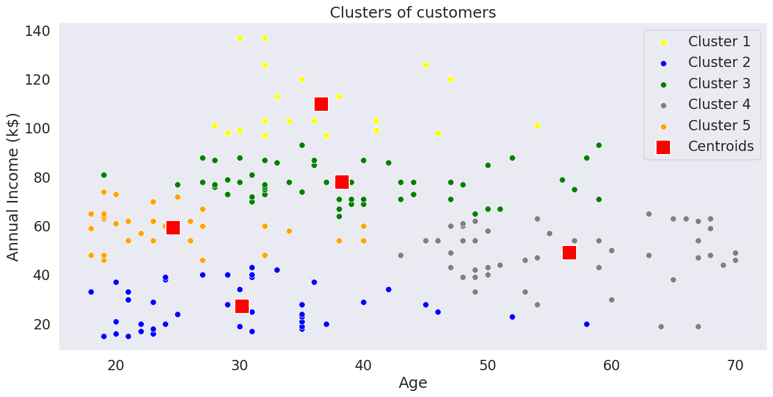
Customer segment based on age and annual income
Segments identified here:
Middle aged people with high annual income, they are the people in their peak career
Old people with average and below average annual income
Young people with average income

Slide 14
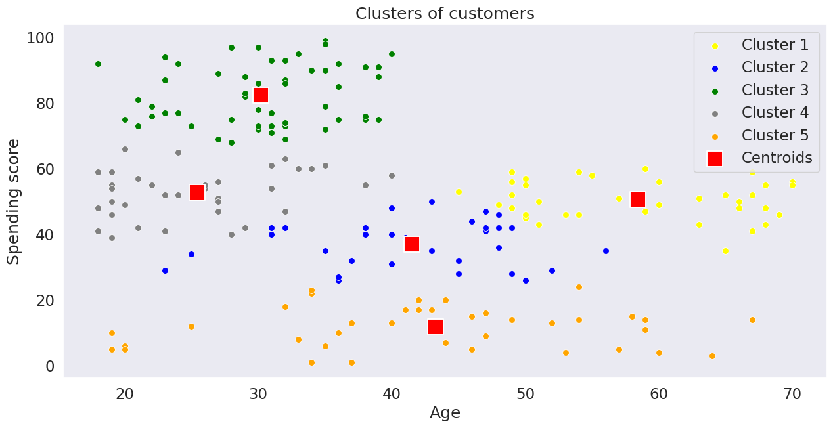
Customer segment based on age and spending score
Other than young people with high spend segments, no other segments is clearly formed here

Slide 15
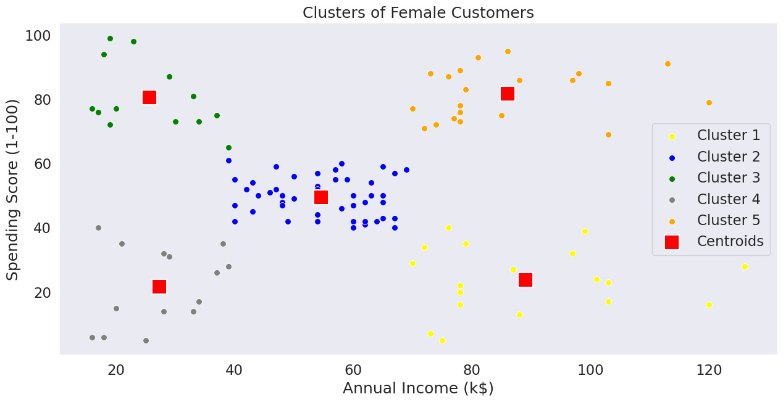
Gender wise segment based on annual income and spending score - Female
Clearly follows the same segment behaviour as whole data

Slide 16
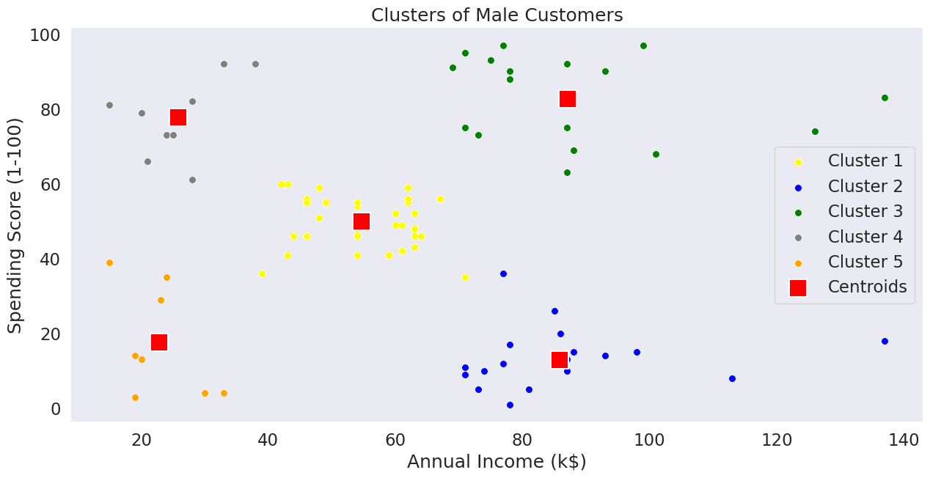
Gender wise segment based on annual income and spending score - Male
Male and Female has identical segments based on spend behaviour

Slide 17
Customer spend Insights
Men and women has almost identical spending behaviour across age groups
Younger people (Age 20-40) spend more compared to older people
Customer spend behaviour can be segmented into 5 different spend groups:
Low income low spenders
Low income high spenders
Average income average spenders
High income low spenders
High income high spenders
Shops can use this segments to do a targeted promotion or marketing
Banks or financial institutes can use these segments to do a target sell of their products. E.g: Target credit cards or personal loans to high spenders in low and high income group

Slide 18
Customer spend Insights
Low income High spenders
High income High spenders
Low income low spenders
Average income average spenders
High income low spenders

Slide 19

Thank you
By: Sharan Sasi
Email: sharanssi@gmail.com

